Slide 1
10/12/2022
Today’s lecture is intended to help you achieve the following learning objective: Summarize the purpose of a molecular mechanics force field. Identify the terms in the molecular mechanics force field.
Molecular mechanics force fields
What are they?
How are they useful?
What are made of?
What are their limitations?
Final project
Overview
Team meeting

Slide 2
Molecular Mechanics Force Fields

Slide 3
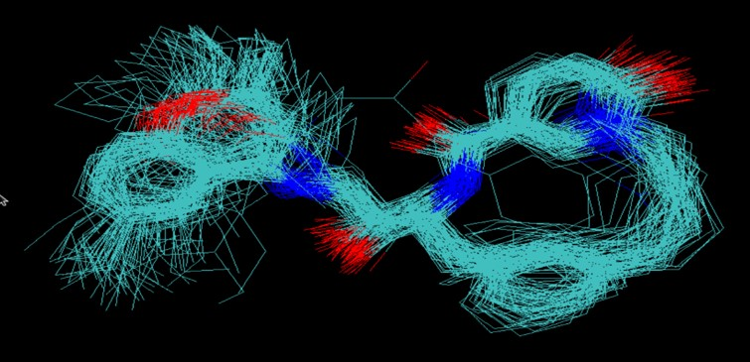
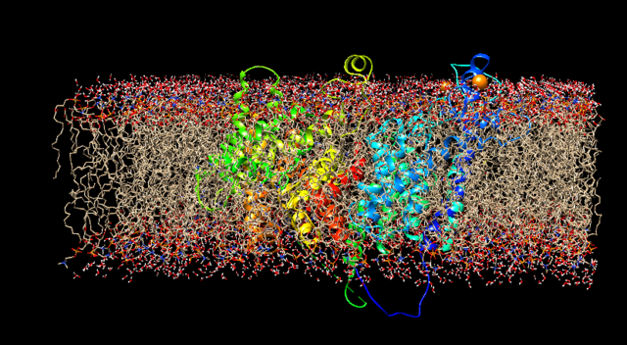
What are molecular mechanics force fields?
E(x) - an equation describing the energy of a configuration of particles
Input: positions of particles in a system
particles are usually atoms, but can be
collections of atoms (e.g. amino acid) in coarse-grained force fields
electrons pairs in a Drude oscillator model
Output: potential energy
Some systems described by molecular mechanics
Configurations of an organic molecule
NaNQR in a membrane

Slide 4
How are they useful?
Energy optimization provides reasonable structures
Helpful for building models that fit to experiment. AMBER (Assisted Model Building with Energy Refinement) is a popular force field.
Basis for many scoring functions in molecular docking.
Gradients are helpful for optimization and to calculate forces in molecular dynamics simulations
According to the Boltzmann distribution, energies specify probabilities, $p(x)∝e^{-βE(x)}$.

Slide 5
What are they made of?
From Figure 3 of
Durant and McCammon, 2011
The potential energy of a system can be divided into those caused by interactions between atoms that are chemically bonded to one another and those caused by interactions between atoms that are not bonded. Chemical bonds and atomic angles are modeled using simple springs, and dihedral angles (that is, rotations about a bond) are modeled using a sinusoidal function that approximates the energy differences between eclipsed and staggered conformations. Non-bonded forces arise due to van der Waals interactions, modeled using the Lennard-Jones potential, and charged (electrostatic) interactions, modeled using Coulomb's law.
Taken from Figure 3 of Durrant & McCammon, 2011.

Slide 6
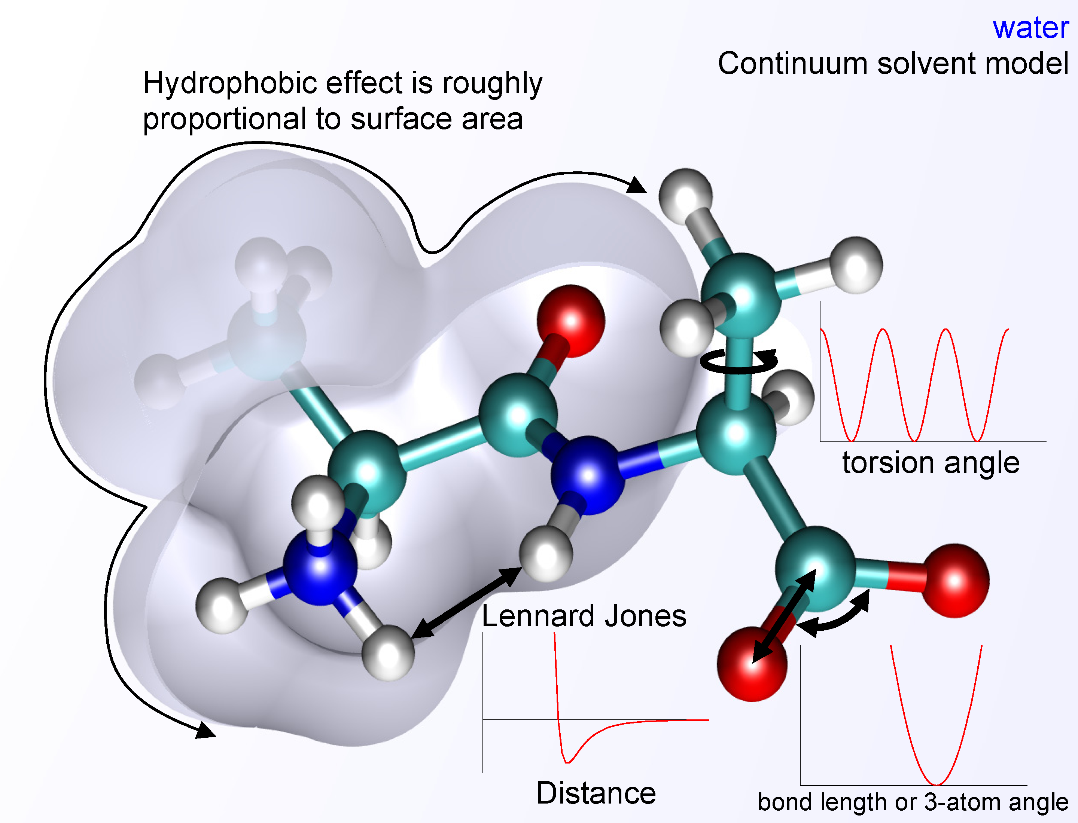
Bonded Interactions
are between atoms that are covalently linked by three or fewer bonds
$$E_{bonds}=\overset{Bonds}{\underset{i}{∑}}\frac{k_{i}}{2}{\left(x_{i}-x_{i,o}\right)}^{2}$$
$$E_{angles}=\overset{Angles}{\underset{i}{∑}}\frac{k_{i}}{2}{\left(ω_{i}-ω_{i,o}\right)}^{2}$$
$$E_{torsions}=\overset{Torsions}{\underset{i}{∑}}\frac{V_{i}}{2}\left[1+cos(n_{i}ϕ_{i}-γ_{i})\right]$$
$$E_{bonded}=E_{bonds}+E_{angles}+E_{torsions}$$

Slide 7
Nonbonded Interactions
are between atoms that are not covalently linked or linked by more than three bonds
$$E_{Coloumbic}=\sum_{i,j}^{Atomswithi<j}{\frac{q_{i}q_{j}}{εR_{i,j}}}$$
$$E_{Lennard−Jones}=\sum_{i,j}^{Atomswithi<j}{\frac{A_{i,j}}{{R_{i,j}}^{12}}−\frac{B_{i,j}}{{R_{i,j}}^{6}}}$$
based on $4ϵ\left[{\left(\frac{σ}{r}\right)}^{12}-{\left(\frac{σ}{r}\right)}^{6}\right]$
$E_{Non−Bonded}=$ $E_{Coloumbic}+E_{Lennard−Jones}$
https://gpantel.github.io/computational-method/LJsimulation/

Slide 8
Where do parameters come from?
QM + experiment
AMBER (as discussed in Tian 2020)
“we also included in ff14SB a small empirical adjustment to ff99SB (using TIP3P water) to improve agreement with NMR data for short alanine peptides”
Quantum chemistry data in implicit solvent (opposed to gas)
OpenFF 2.0.0 (https://openforcefield.org/force-fields/force-fields/)
A select set of the vdW parameters were trained against a set of experimental mass density and enthalpy of mixing measurements sourced from the NIST ThermoML archive.
A select set of the bond length, bond force constant, equilibrium angle, angle force constant and torsion barrier height parameters were trained against a set of QC computed optimized geometries and torsion profiles, whereby the output force field of the first step was used as the starting point.

Slide 9
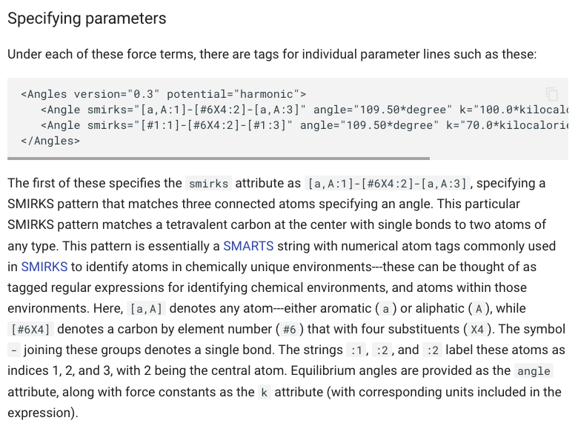
SMIRNOFF specification, in Open Force Field
https://openforcefield.github.io/standards/standards/smirnoff/#parameter-generators

Slide 10
Solvent
Usually water, but may be other solvents
Ions
Popular water models include
SPC (simple point charge)
TIP3P (transferable intermolecular potential with 3 points)
OPC (Optical point charge), to reproduce electrostatics of water
These have LJ site for O and two charge sites.
Jo S, Kim T, Im W (2007)

Slide 11
Implicit Solvent
Solvent can make up a large fraction of atoms in a system and can dampen motions in a molecular simulation
Explicit solvent - 3D positions are modeled in the system
Implicit solvent - effects of solvent are modeled.
Two popular models are Poisson-Boltzmann Surface Area (PB/SA) and Generalized Born Surface Area (GB/SA)
Poisson-Boltzmann equation used to describe electrostatic energy of inserting charges into solvent. Generalized Born approximates PB.
Nonpolar cavity formation energy based on surface tension x surface area of solute.
Bureau HR, Merz DR Jr, Hershkovits E, Quirk S, Hernandez R (2015)

Slide 12
Periodic Boundary Conditions
To mitigate boundary effects, unit cell assumed to be surrounded by infinite number of identical copies
Particles that pass through boundary reappear on the other side
Particles usually interact with closest image (minimum image convention)
PBC affects energy
Short-range electrostatics treated by Coulomb’s law
Long-range electrostatics treated by Ewald sum
https://lammpstube.com/2019/10/30/periodic-boundary-conditions/

Slide 13
What are their limitations?
Potential energy less accurate than quantum mechanics. Based on Tian 2020, some key approximations are that
Bonded terms are independent and additive
Parameters are transferrable between molecules (e.g. from small organic molecules to proteins)
“The relative scarceness of experimental data compared to the number of parameters in the FF leaves the empirical fitting problem severely underconstrained.”
Cannot model bond formation or breaking
Popular fixed-charged force fields do not account for polarization

Slide 14
References
Durrant, J. D.; McCammon, J. A. Molecular Dynamics Simulations and Drug Discovery. BMC Biol 2011, 9 (1), 71. https://doi.org/10.1186/1741-7007-9-71, adapted under the CC BY 2.0 license.
Jo S, Kim T, Im W (2007) Automated Builder and Database of Protein/Membrane Complexes for Molecular Dynamics Simulations. PLoS ONE 2(9): e880. https://doi.org/10.1371/journal.pone.0000880, adapted under the CC BY 4.0 license.
Bureau HR, Merz DR Jr, Hershkovits E, Quirk S, Hernandez R (2015) Constrained Unfolding of a Helical Peptide: Implicit versus Explicit Solvents. PLoS ONE 10(5): e0127034. https://doi.org/10.1371/journal.pone.0127034, adapted under the CC BY 4.0 license.
Tian, C.; Kasavajhala, K.; Belfon, K. A. A.; Raguette, L.; Huang, H.; Migues, A. N.; Bickel, J.; Wang, Y.; Pincay, J.; Wu, Q.; Simmerling, C. Ff19SB: Amino-Acid-Specific Protein Backbone Parameters Trained against Quantum Mechanics Energy Surfaces in Solution. J. Chem. Theory Comput. 2020, 16 (1), 528–552. https://doi.org/10.1021/acs.jctc.9b00591.

Slide 15
Final Project
Overview https://daveminh.github.io/Chem456-2022F/assignments/
Team meeting
Q&A with target presenter
Brainstorm possible project goals
Discuss feasibility of ideas with me

